Slide 1

iCare
Harmony and Convenience

Slide 2

Team Members
12301104 Lu Yunfeng 卢运烽
12301101 Li Zhe 李喆

Slide 3
Brief Introduction of this application

Slide 4
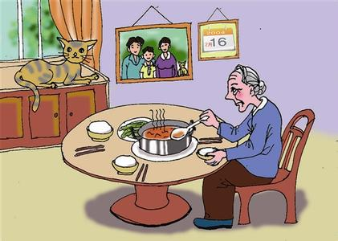
Some elders are living alone in modern China

Slide 5
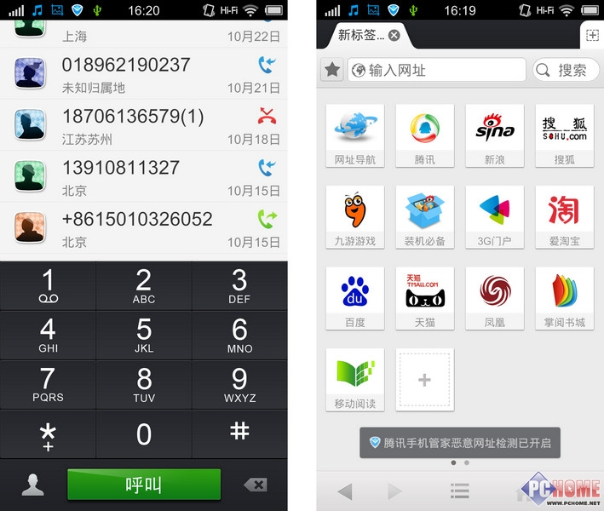

They may find it difficult to dial their children`s phone number
The Button is too small and I couldn’t memorize the phone number!

Slide 6

They may lose their way when they leave their home

Slide 7
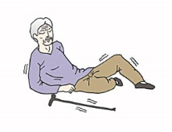
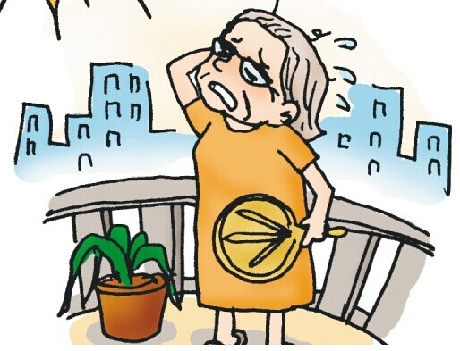
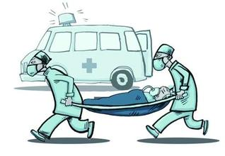
They may face danger or sudden illness

Slide 8
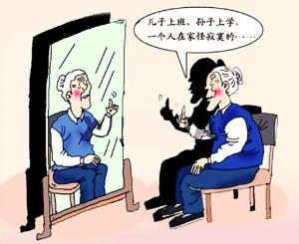
They may feel bored because of living alone
My son is working, and my grandson is in school now. I feel so bored living alone…

Slide 9
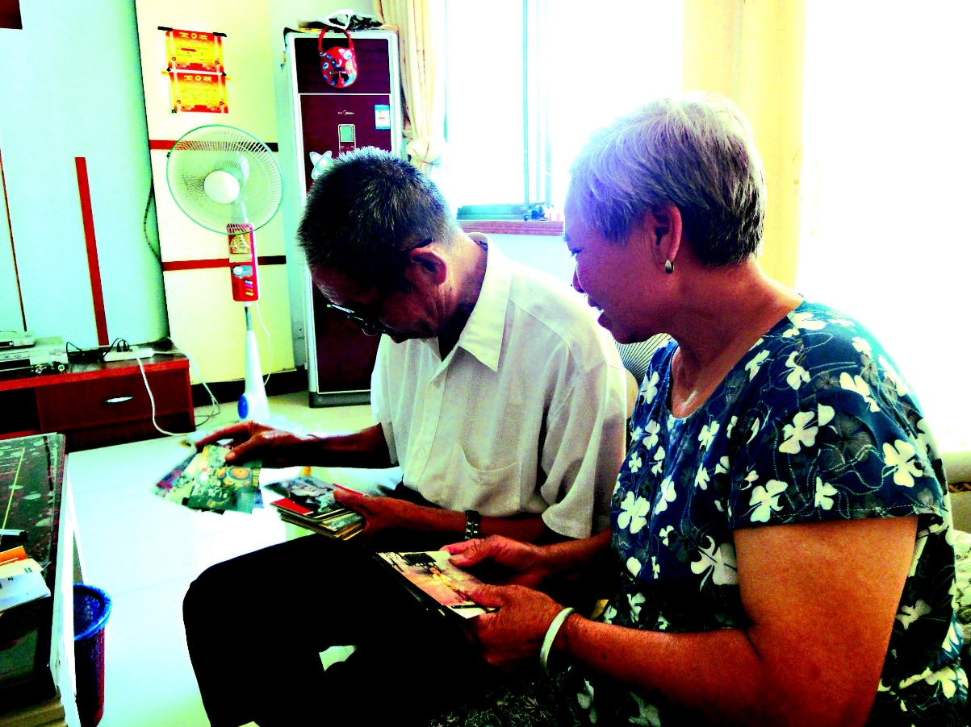
Sometimes their only need is to have a look at their children

Slide 10

Or hearing the voices of their children

Slide 11
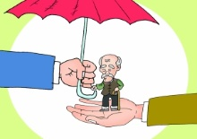
And get assistance in emergencies

Slide 12
Their needs are our working goals

Slide 13
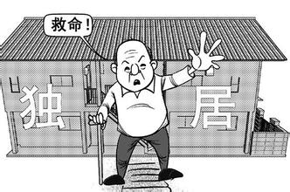

We provide services especially for
60
Old people age over
Living alone
Need caring

Slide 14

Not only the elder, but also the whole family

Slide 15
What can we do for the elder?

Slide 16
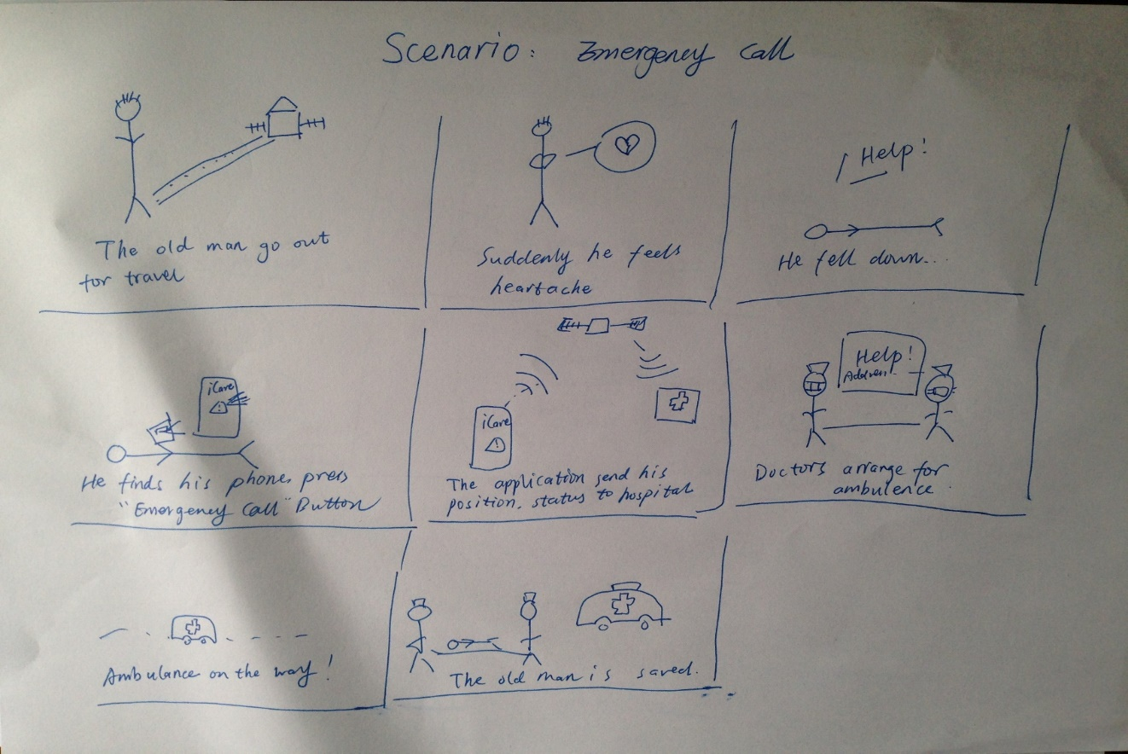
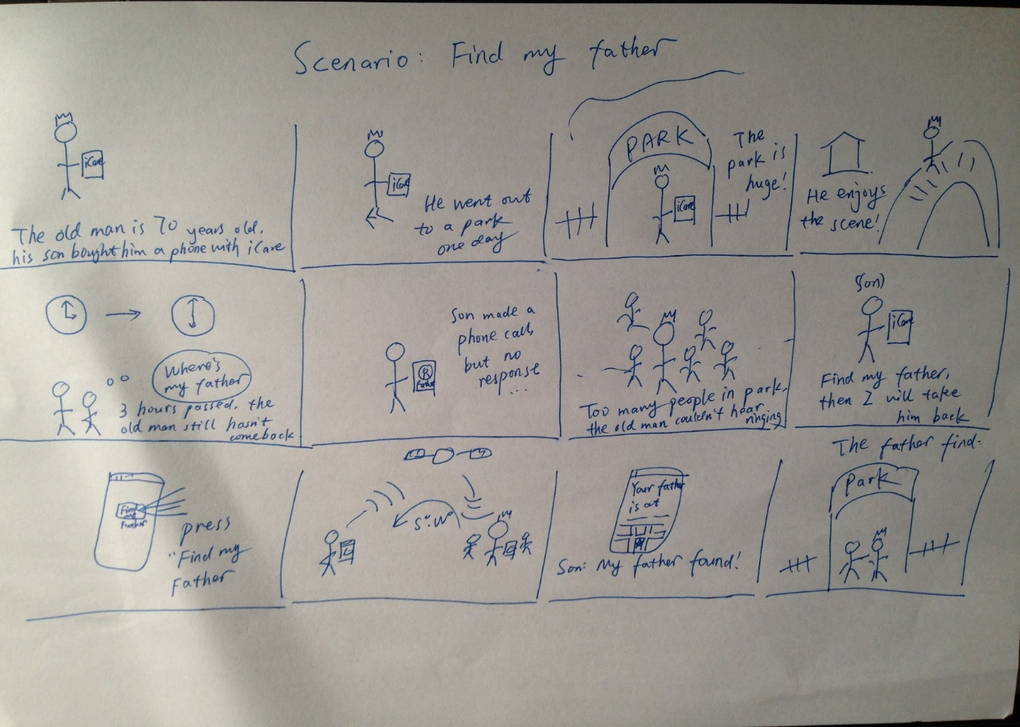
Our steps of design

Slide 17
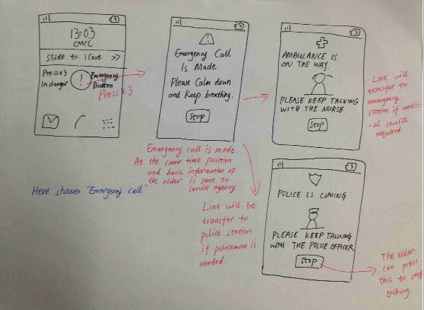
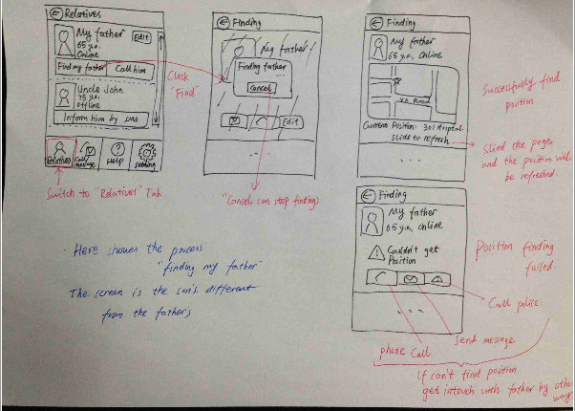
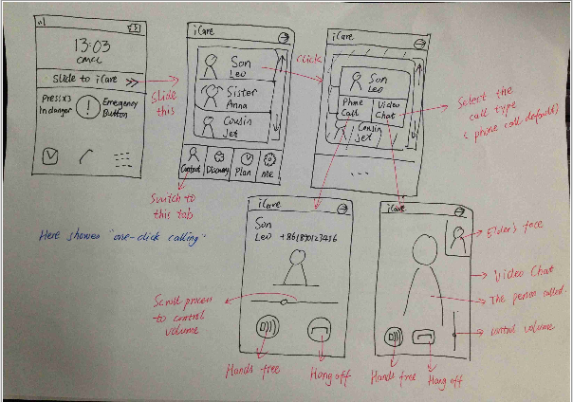

Slide 18
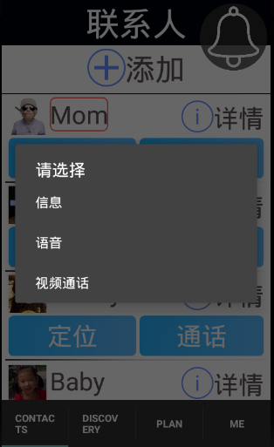
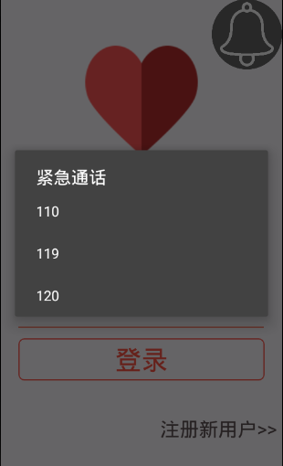
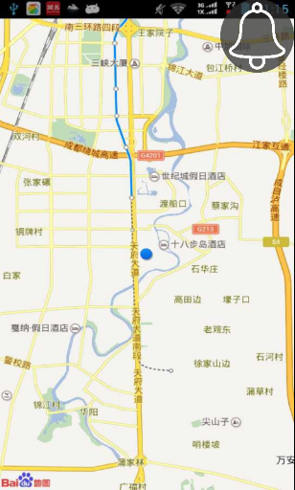
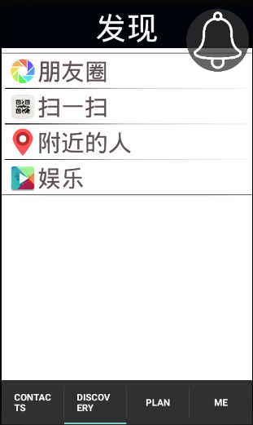
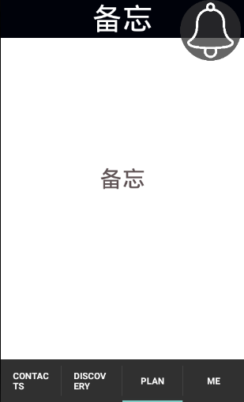
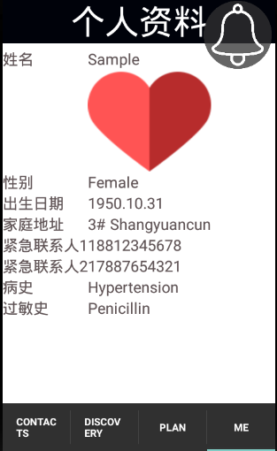
Our Main functions
One-button call
Emergency call
Location Query
Entertainment
Notes
Personal Profile
… and so on

Slide 19
Now we will show the most attractive function of our application

Slide 20

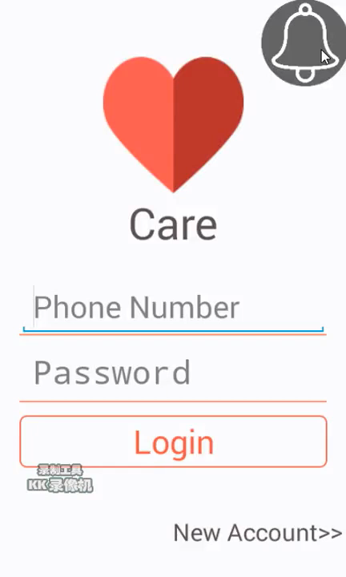
Emergency Call

Slide 21
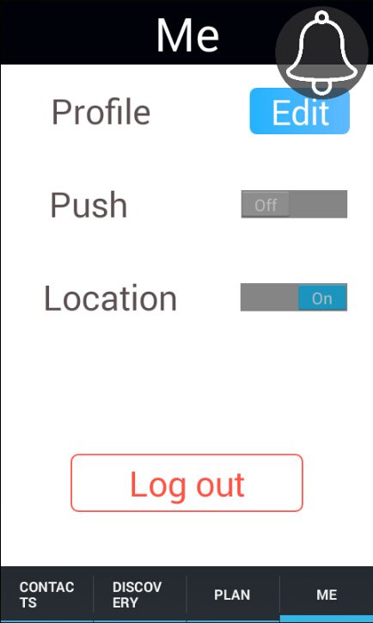
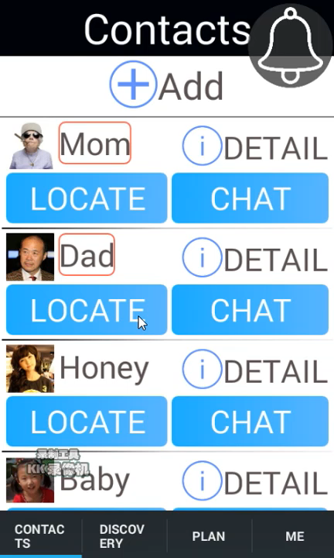
Location

Slide 22
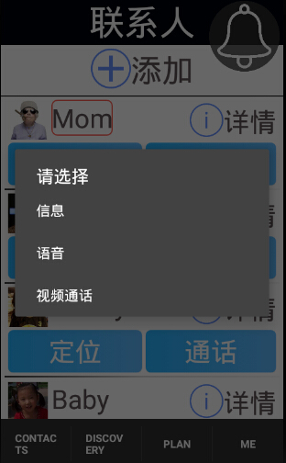
3 Kind of ways to chat

Slide 23
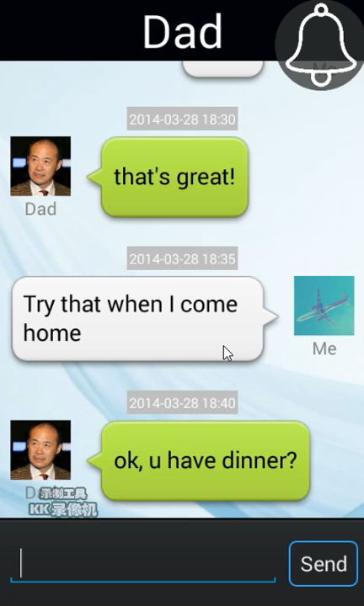
Text Messages

Slide 24
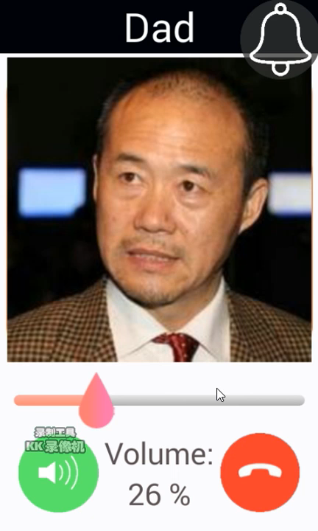
Phone Call

Slide 25
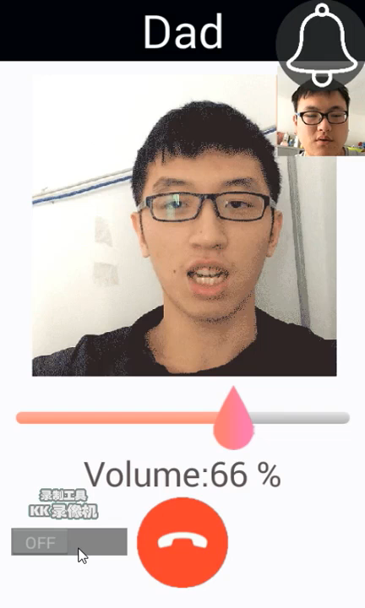
Video Call

Slide 26


Slide 27
Future steps of our application

Slide 28
More functions will be added
-Daily Plan
-Floating window in main screen
-Heartbeat/blood pressure monitoring
-… and so on

Slide 29
We are dreaming to set up a social company, to afford service to the elder.

Slide 30
We will cooperate with government and hospital, link the application with public services.

Slide 31
Thank you!

